Slide 1

Data Strata
2021
Members:
Md. Faizal Karim(2012027)
Krishnav Rajbangshi(2012083)
Rahul Singh(2016014)

Slide 2
Information about the data set provided
The data set is based on the results of The Public 2020 Stack Overflow Developer Survey.
A total of 64461 responded to the survey.
The scope of the survey are people who are generally on the internet and use Stack Overflow, hence the respondents are mostly developers or those who are interested in development.

Slide 3
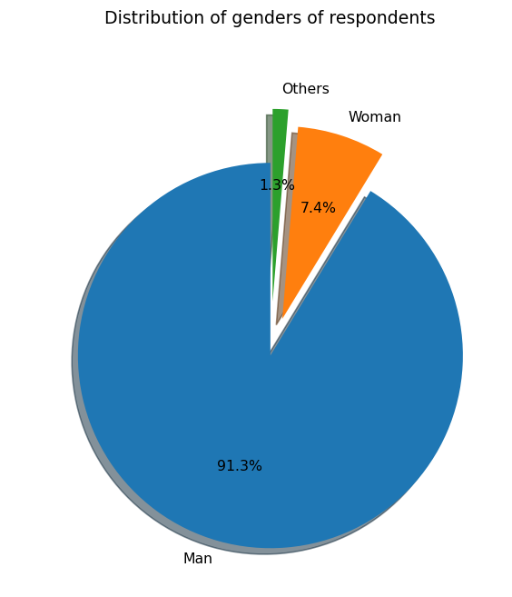
Gender distribution
As per the pie-chart, the number of men who took the survey is far higher than that of women or others.
There exists a significant gender gap among the developers.

Slide 4
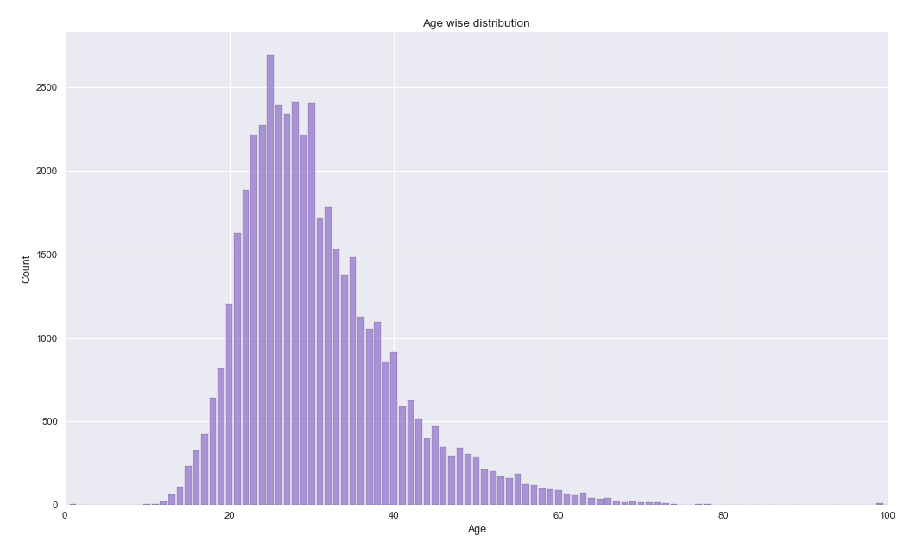
Age wise distribution of the respondents
Majority of the developers are the between the ages of 20 and 30
This is primarily because at this age group people graduate and start their careers as developers.
It has been observed that most developers get out of the field by the age of 40.

Slide 5
Whether they code as a hobby
Yes | 50388 (78.22%)
No | 14028 (21.78%)
Most people code as a hobby and they believe it to be a fun and creative job.

Slide 6
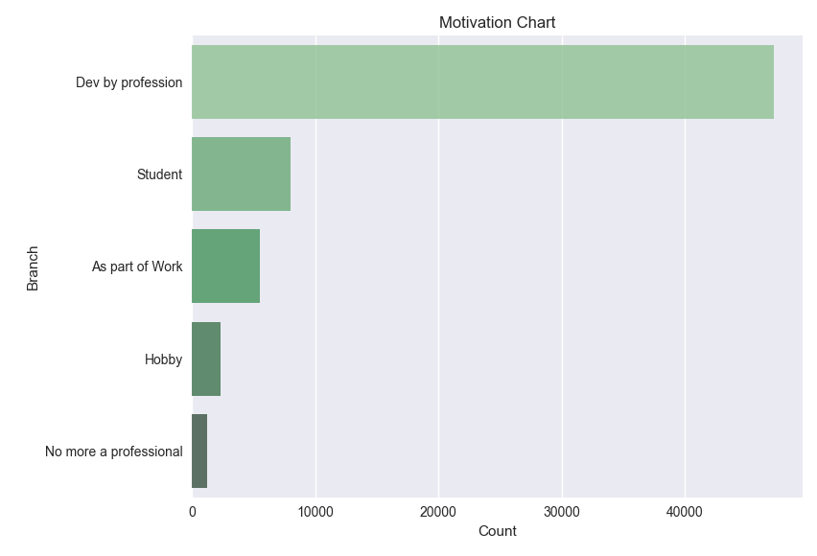
Most of the respondents are developers by profession and only a few have changed their fields.
Students indulge themselves into development more than people who do it as part of work.
One possible reason might be that students wish to pursue a career in development.

Slide 7
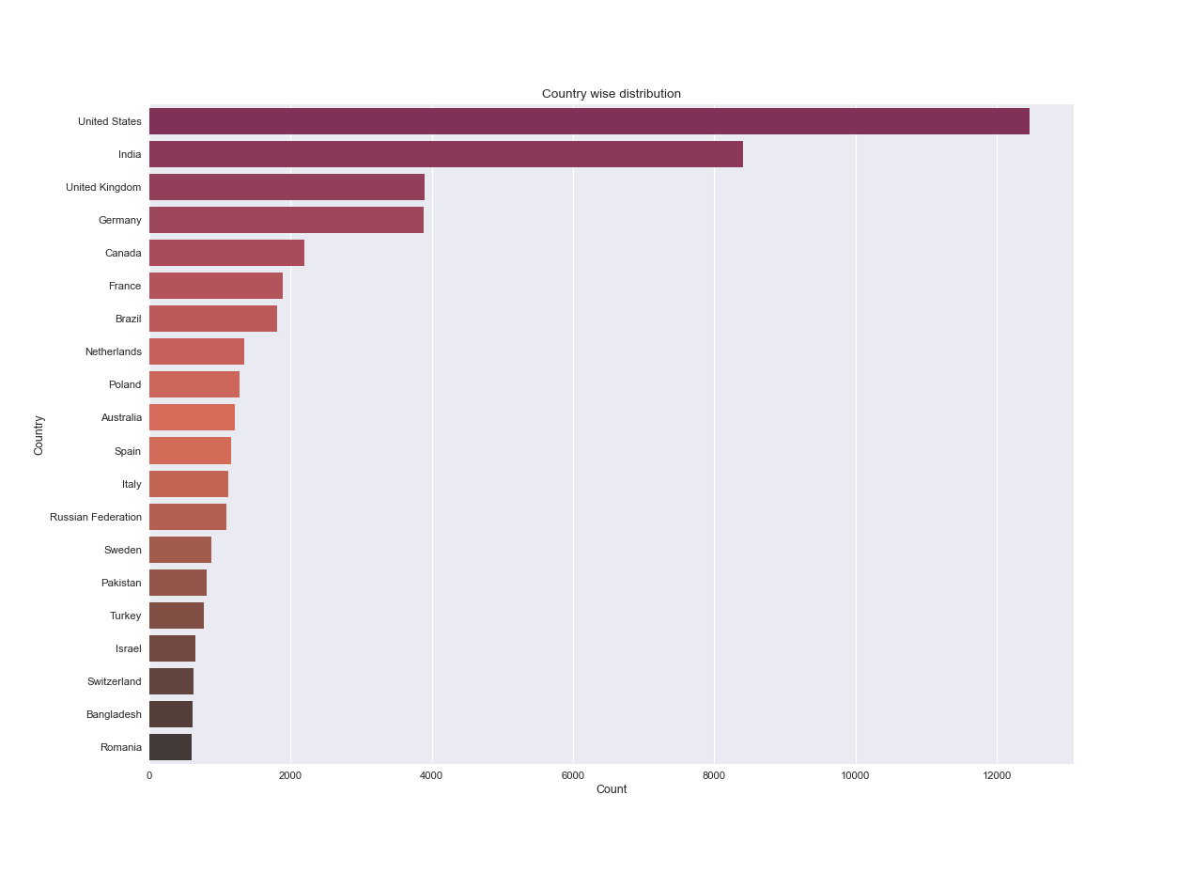
Country wise distribution

Slide 8
Insights
It has been observed from the graph in the previous slide that most of the respondents are from the United States, India, and the United Kingdom.
This suggests that people from the above mentioned countries are more interested in the field of development and hence contribute more towards software development.

Slide 9
Education, work, and career

Slide 10
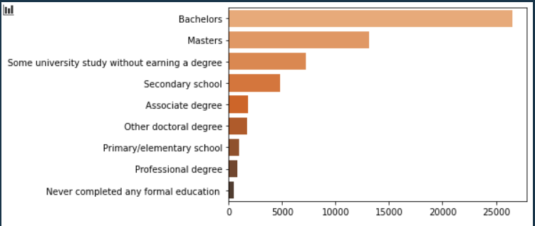
Highest level of formal education

Slide 11
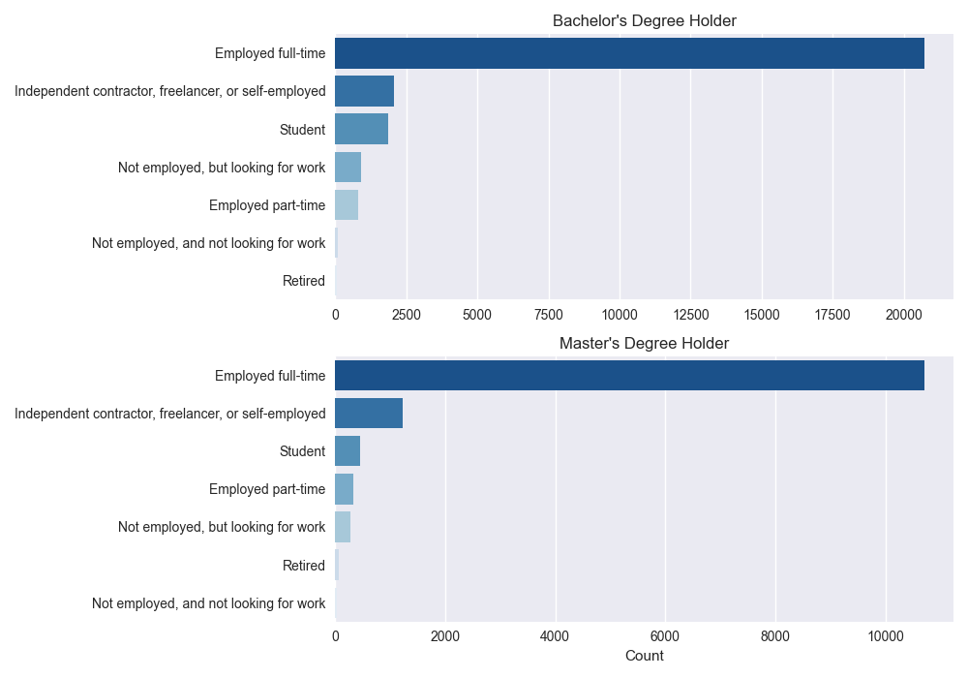

Slide 12
Insights
It can be observed from the previous graphs that most of the developers start their career right after their bachelor’s degree.
People who complete their bachelor’s or master’s degree gain the necessary skills to work in the field of development and work as a full time developer.

Slide 13
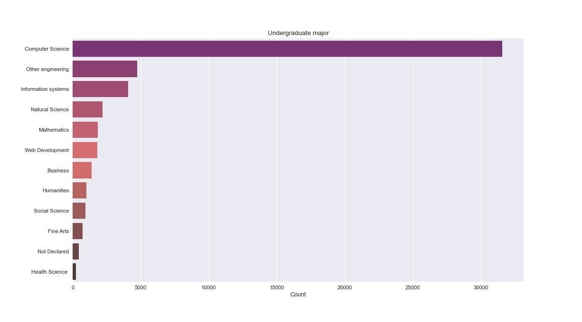
Undergraduate majors pursued by developers

Slide 14
Insights
Majority of the developers had pursued a major in Computer Science as an undergraduate.
Computer Science is the most preferred course for those who desire to pursue a career in development followed by other engineering courses, and IT courses.
One possible reason is that a CS course provides students with the necessary skills and knowledge required to work in the field of development.

Slide 15
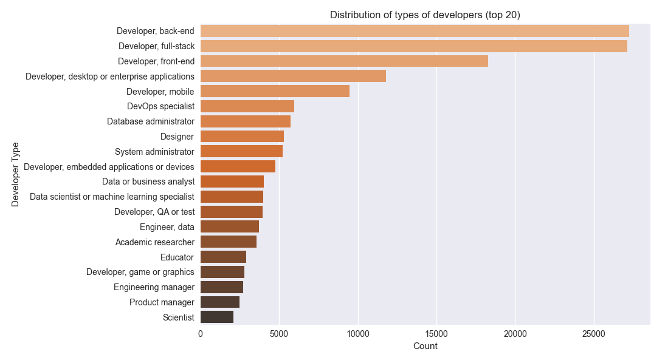
Types of developers

Slide 16
Insights
Web and app development are the most popular fields for a developer.
Nowadays, many more large companies are demanding more front end and back end developers, mainly startups. Due to Startups increasing and also the usage of smart devices increases, which are on app-based or web-based businesses solely based. Hence, front and back end development are the most sought after fields.

Slide 17
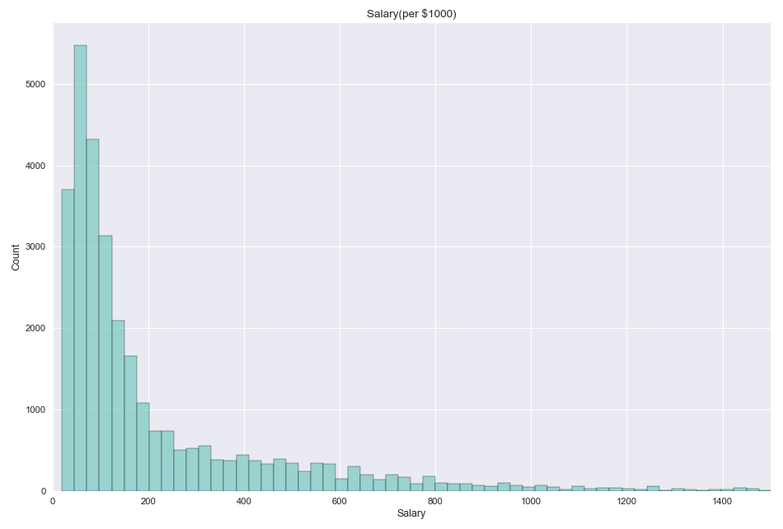
Payscale

Slide 18
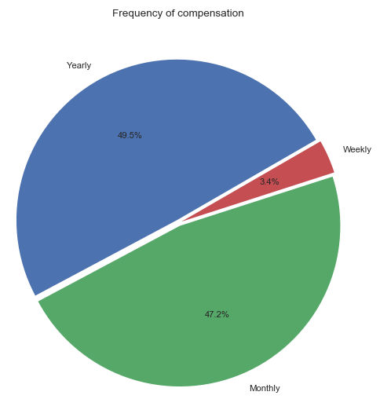
Insights
The salaries of most developers are in the range $70K to $120K per year.
It can be concluded that a developer is fairly compensated for their job.

Slide 19
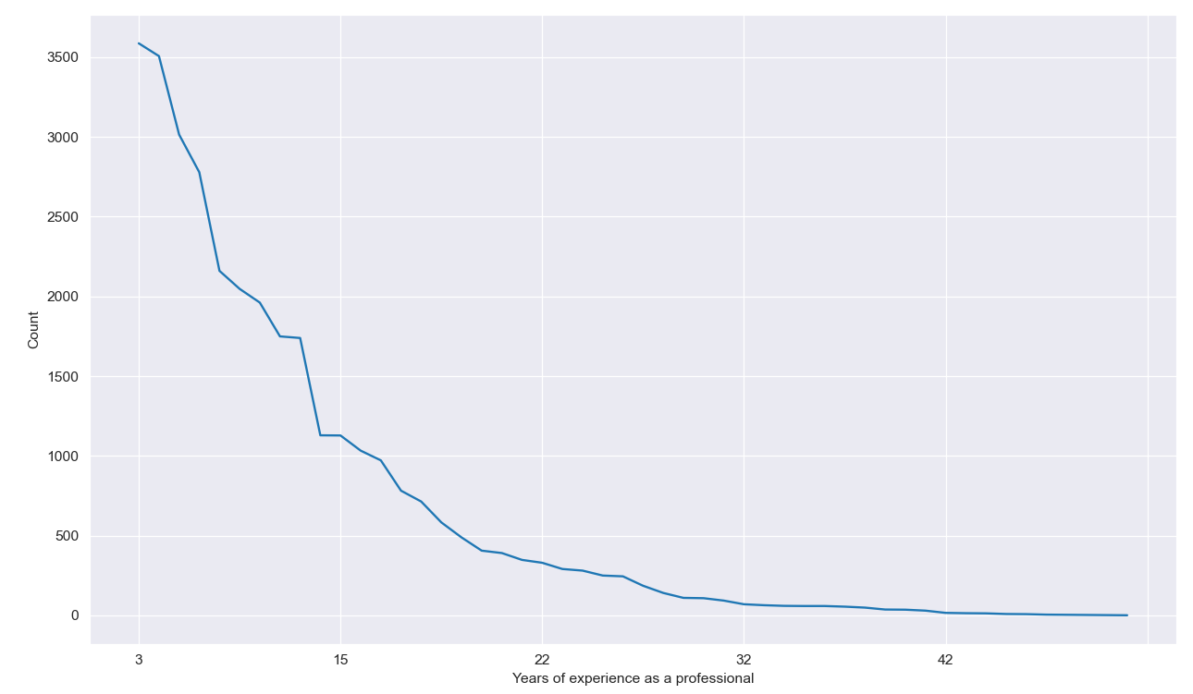
Years of experience as a professional developer

Slide 20
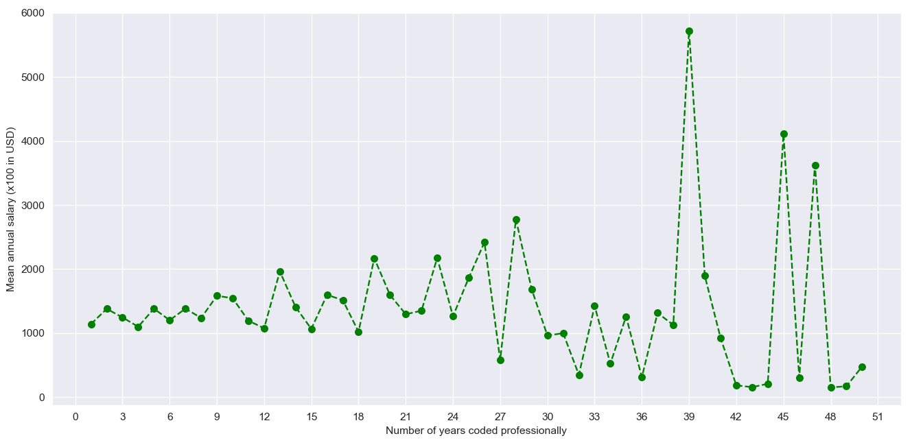
Comparison of salary with experience

Slide 21
Insights
Developers with experience less than five years earn as much as those with more than ten years of experience.
A general trend can be observed that with experience the compensation increases.

Slide 22
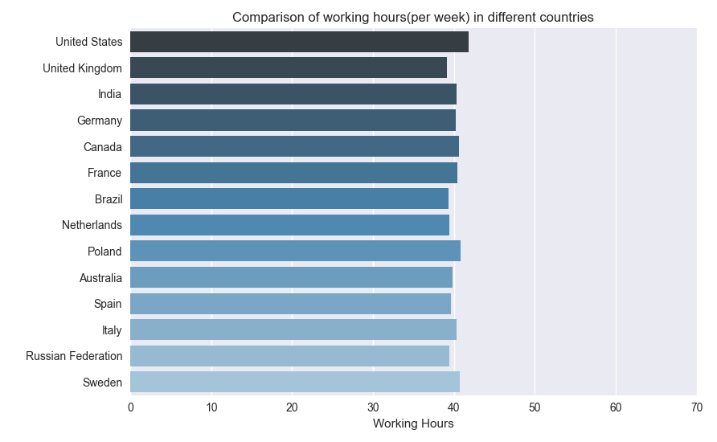
Working hours in different countries
As the graph suggests, working hours are almost the same in all countries.
It suggests that developers do the same amount of work around the world.
The average is around 40 hours per week.

Slide 23
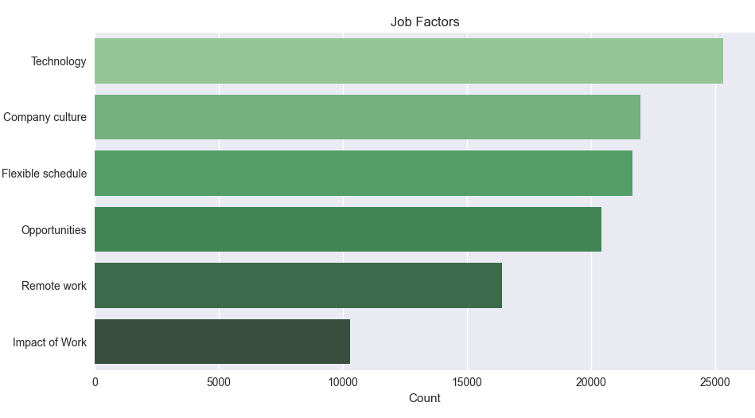
Job factors developers look for
Developers look for what languages and frameworks they would be working with at their job.
Company culture, flexible schedule and opportunities are what developers look for in a job.

Slide 24
Tech and tech culture

Slide 25
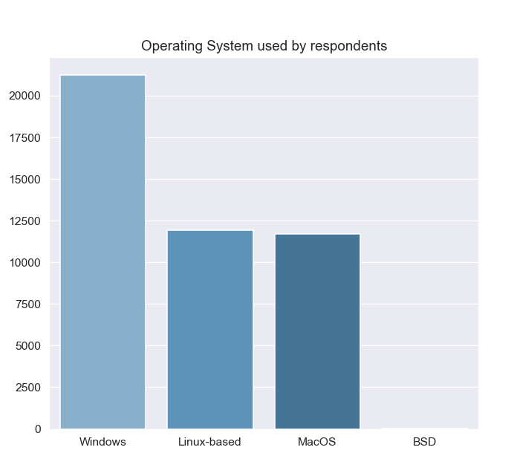
Operating systems used by developers

Slide 26
Insights
Windows is used by the maximum number of respondents as it is easy to use and allows programmers to test apps in developer mode.
Some prefer to use MacOS as it has better cross-platform compatibility.
Others prefer Linux as it works well on older hardware, and has better interoperability.

Slide 27
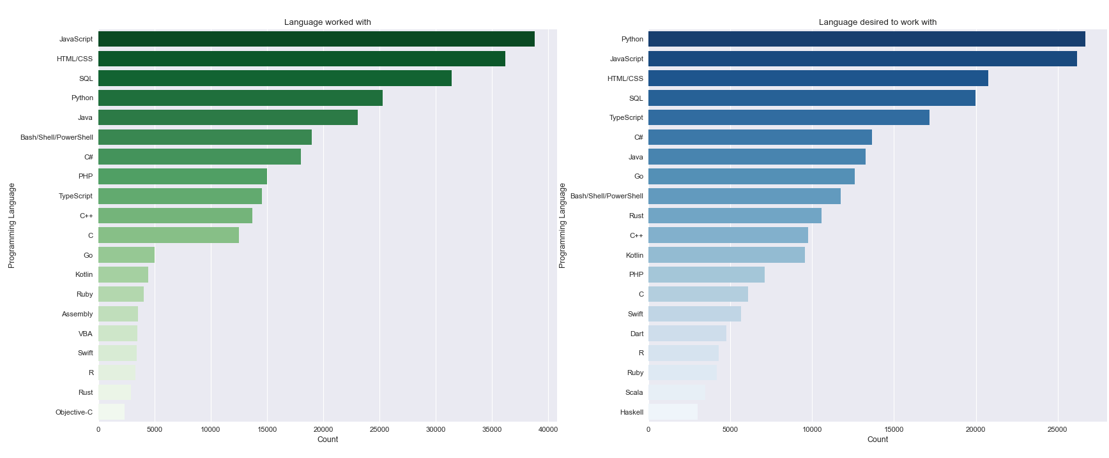
Programming language used/desired

Slide 28
Insights
JavaScript is the most widely used language followed by HTML/CSS, and SQL. This is primarily because web development is the most popular field among developers.
People desired to work with Python as the fields of data science, ML, AI etc. are getting more recognition and python is used for programming in these fields.
Kotlin showed a huge increase in the number of people interested in it.

Slide 29
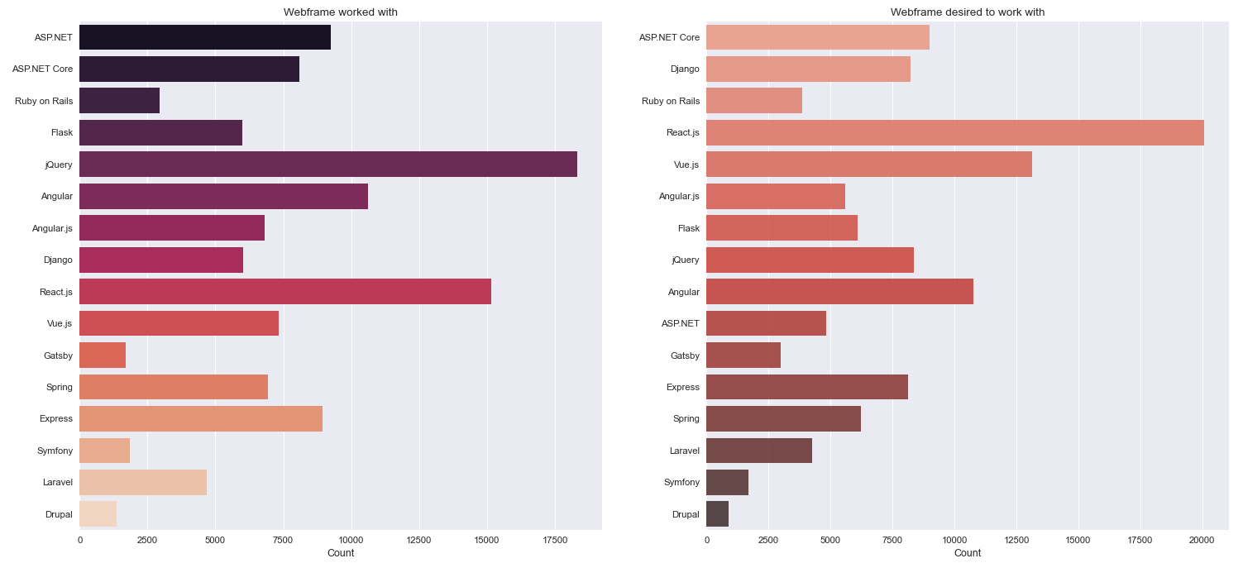
Webframe used/desired

Slide 30
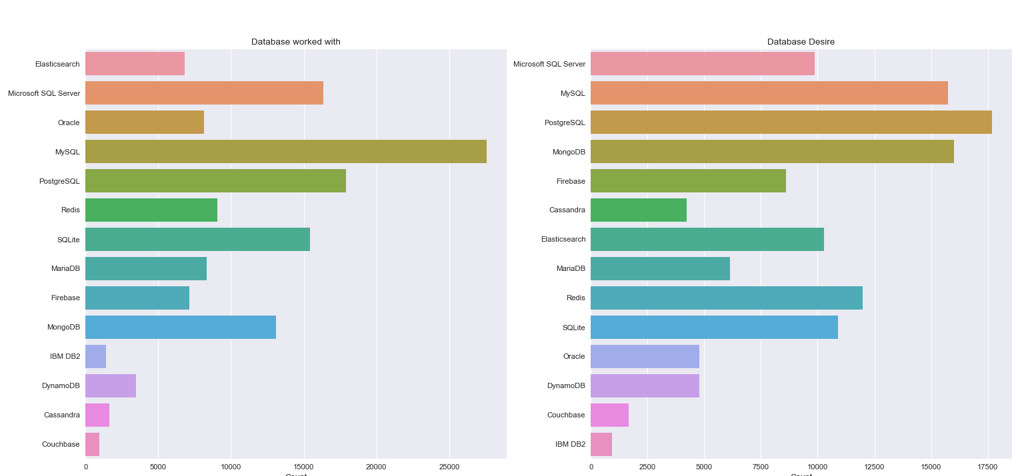
Database used/desired

Slide 31
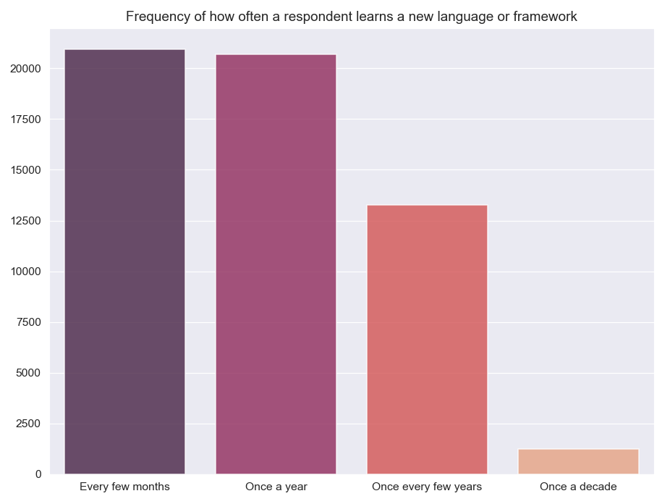
Frequency of learning new language/framework
Most developers learn a new language or framework frequently and keep themselves updated regarding the present technology.
It can be concluded that to be a good developer one must keep learning new things and be able to apply them to solve problems.

Slide 32
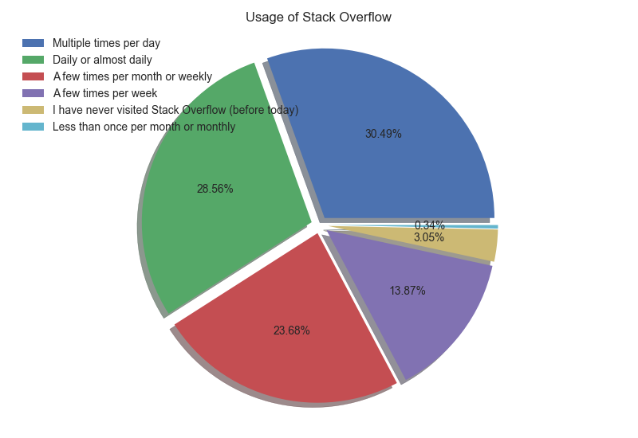
Stack Overflow-usage and community
Has stack overflow account?
Yes | 47275 (88.2%)
No | 6101 (10.7%)
Not sure | 3429 (6.1%)

Slide 33
Insights
According to the pie-chart in the previous slide, a large number of developers use Stack Overflow on a daily basis.
Hence, Stack Overflow has been proven to be an essential forum for doubts/discussions among the developers.

Slide 34
What is the best approach/situation for becoming a successful developer?
It is preferable to start learning skills that are required for development before the age of 20, during their undergraduate course.
It is important to have fun while coding and developing rather than viewing it as a cumbersome task.
As the number of developers in the United States, India, and the UK are the highest, one can always look out for these countries for further studies or to start their journey in development.

Slide 35
It is advisable to at least have a bachelor’s degree in order to pursue a career in development as it gives the person the fundamental knowledge and skills required.
Having a major in Computer Science always gives an upper edge for aspiring developers. Nevertheless, a major in IT, or other engineering fields gives one the necessary skills to at least begin their development journey.
A good command on back-end and front-end development would allow one to find a high paying job because of its high demand. Application developers(mobile and desktop), database administrators etc. are also some of the positions that companies look after.
A lucrative payscale always motivates a person to put more effort and do good work.
Having a proficiency in JavaScript, HTML/CSS, SQL, Python, Java provides a wide scope of development which eventually helps in being recruited by good companies.

Slide 36
To become a successful developer, one must have a good knowledge of webframes and databases such as jQuery, React.js, MySQL, MongoDB as these are widely used in projects.
It is important to stay updated with the latest technologies and keep learning new frameworks and languages.
It is a good practice to remain active on platforms such as Stack Overflow as it helps the person to form a better network and help/learn from others.
In the end, a developer should have fun and contribute to the world.

Slide 37
Thank You

